Slide 1

Education for Everyone!…
Online help
Group : EduTech Innovators
By :
Derleen Saini
Kaveri Kesarwani
Ritika Verma
Tanya Jain
(2613-1:Database Management System - Des, Dev & Admin)

Slide 2
Table of contents
01
02
03
04
05
06
Business Scenario
Scope, Purpose & Benefits
EER Model
Relational Model
SQL Database
Conclusion

Slide 3
Nature & Scope
Customers
Soft skills
Study material
Committed to connecting learners with high-caliber instructors and institutions underscores its mission to enhance global education accessibility.
Explore the impact of digital platforms in transcending traditional educational boundaries and offering scalable, quality education solutions to a global audience.
Coursera helps learners worldwide gain the opportunity to engage with cutting-edge educational materials, fostering an environment of lifelong learning and professional development.

Slide 4
Purpose of the Database
Management
Catalog Management
Progress Tracking
User Data
Courses
Enrollment
Awards
Reviews
Content
Certification and Degree Management
Community and Collaboration
Management and
Delivery

Slide 5
Benefits of the Database
Coursera's database architecture is a critical backbone of its platform:
For the business:
Operational Efficiency
Scalability
Data-Driven Insights
Security, Access Control
Anomaly Detection
Backup and Disaster Recovery
For the users:
Professional and academic advancement
Personalized user experience
Analytical and Feedback Mechanism

Slide 6
Business Scenario
Sarah (Student):
Logs in and enroll in ‘Data Science’ course.
Provides payment details and confirms enrollment and receives email confirmation.
Accesses course materials, lecture, assignments and interacts with peers and posts questions on course forum.
Receives personalized feedback from James and participates in Q&A sessions.
Upon completion, receives a notification congratulating her on her accomplishment and survey on the learning experience and suggestions for future improvements.
James (Instructor):
Notified of Sarah's enrollment.
Logs into his account and manage student enrollment.
Provides course content and feedback, and interacts with students.
Lin (Coursera Plus Staff):
Oversee the enrollment process, manage course offerings, and gather feedback to enhance the platform's user experience.
Help

Slide 7

















CONCEPTUAL DATA-MODEL (EER)
Entities
User
Course
Accomplishment
Degree
Certificate
Enrollment
Review
Subject
Specialization
Skill
Module
CourseMaterial
Assignment
Quiz
Lab
Evaluation
Grade
Notes:
-I would brief you all about the analysis phase of our SDLC for coursera platform.
-In our planning phase We started off by gathering the business requirements already mentioned by Darleen.
In order to fulfill the requirements, we have created our conceptual model with total of 19 entities

Slide 8






Entities - Relationships
Disjointness
Completeness
Super and Subtypes
User-Total
Accomplishment-Total
Assignment-Partial
User-Overlap
Accomplishment-Disjoint
Assignment-Overlap
User-Instructor, Student & Staff
Accomplishment - Certificate & Degree
Assignment-Lab & Quiz
Binary
Ternary
Weak
All relationships
One-Many
Many-Many
One-One
Specialization
Course
Skill - Associative Entity
Review-Course
Grade-Assignment
Notes:
-We have covered majorly 4 types of entities in our EER
- the first being the obvious one, the regular entity like the entity course, where we are capturing all the details about courses like its ID, name, and what the course entails.
-The second type of entity we are using is supertype-subtype, along with Disjoint as well as Overlapping Supertype-subtype entities: let's take User entity on the top-right as an example here for overlapping subtypes (containing student, instructor, and in addition we have one more user type called staff containing coursera employees conducting daily business activities on the database). We have implemented supertype-subtype here to have role-based access control for proper segregation of duties.
-The Third type of entity we are using are Weak entity like review, to capture its dependency on courses.
-Lastly, we have Associate Entity like skill, to showcase relationship between courses and their specialization.
-In terms of relationships, for degree we have binary and ternary.
-And cardinalities, we have one-one, one-many and many-many

Slide 9
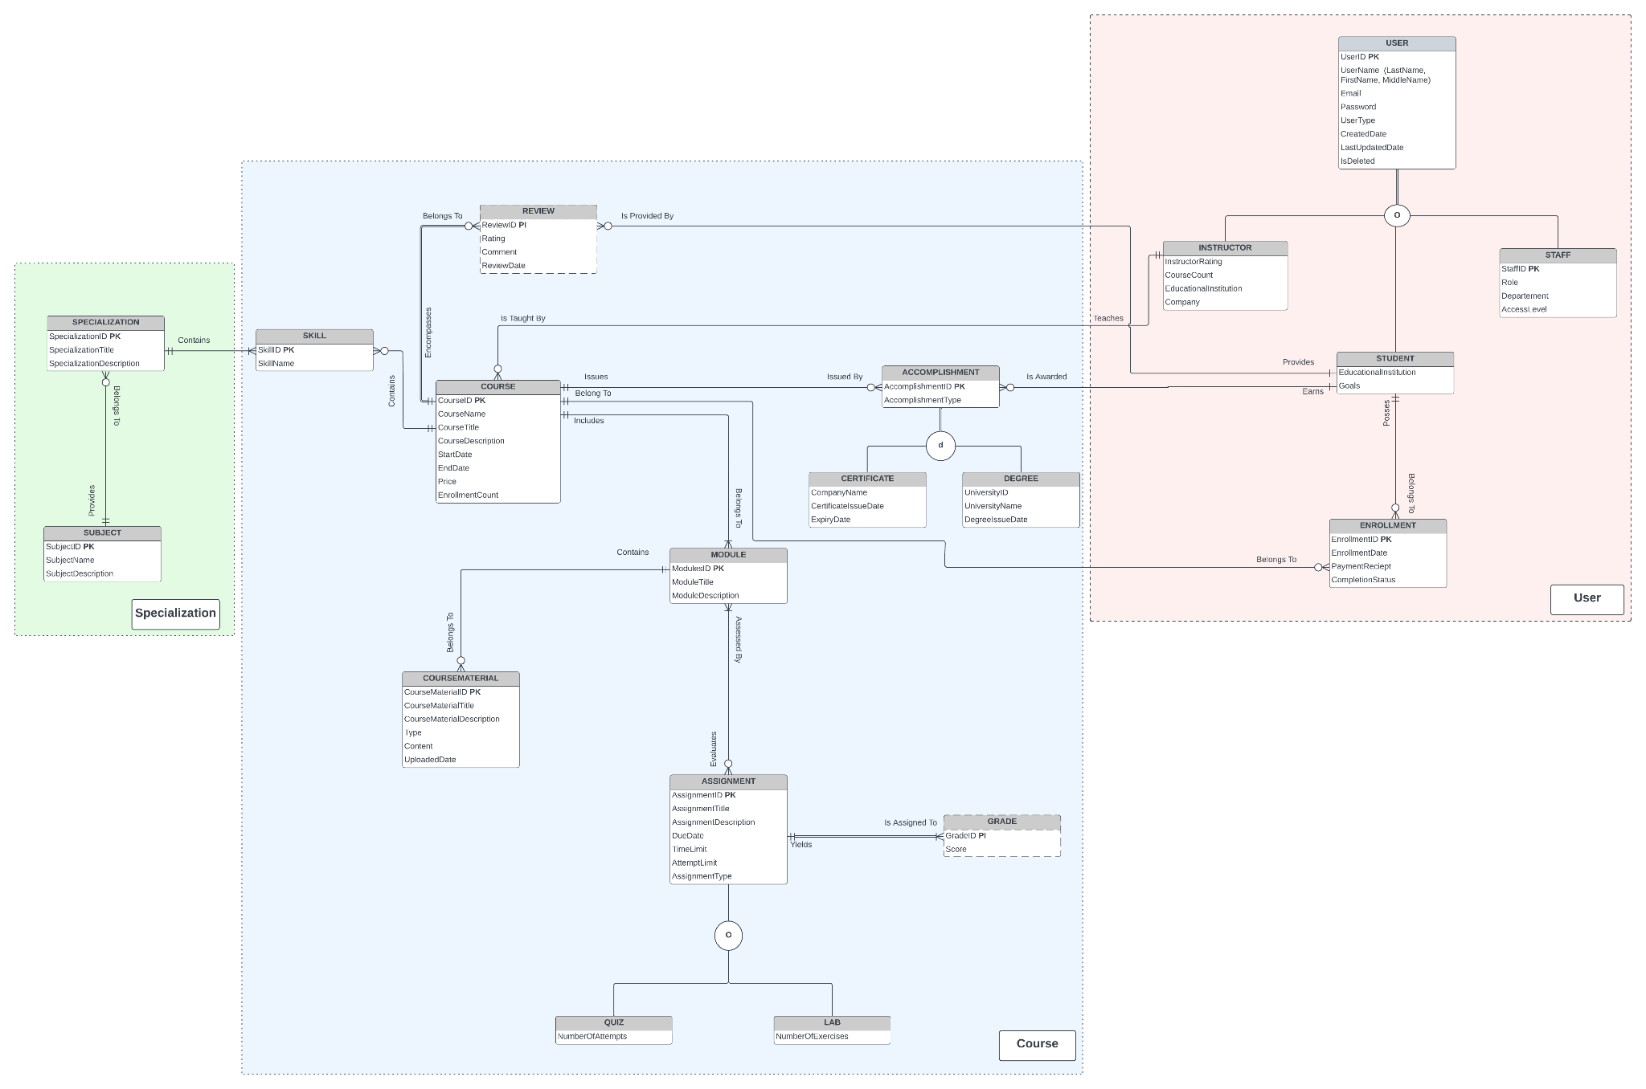
EER MODEL
EER MODEL
Notes:
At the end of our analysis phase -
This is our final EER diagram capturing, the business requirements.
Lastly, to implement data disclosure on need to know basis only, we have defined entity clusters namely - user / specialization / course.

Slide 10
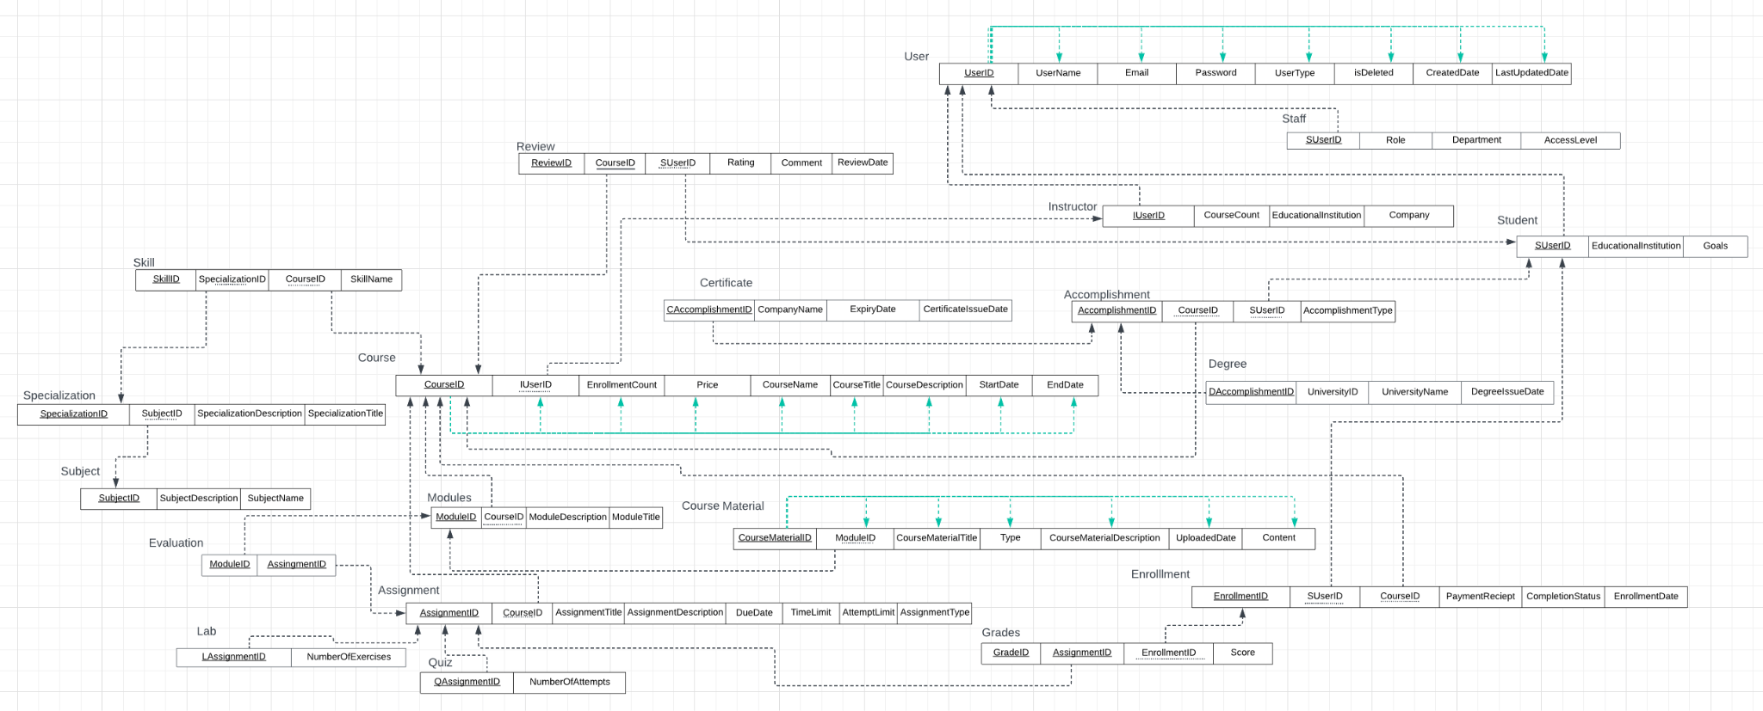
Relational Model
Notes:
Logical database design
-Coming to the design part of software development life cycle
-we transferred the conceptual data model (ER/EER model) into a logical data model
-this model is about creating stable database structures
– which is consistent and compatible with a specific type of database technology
Which is MYSQL in this case
-which can help to correctly express the requirements in a more technical language
19 entities-20 relations-evaluation many to many between assignment entity and module entity
All relations are in the third normal form where all non key attributes are are fully dependent on only the primary key attribute
we have represented a few with green lines

Slide 11
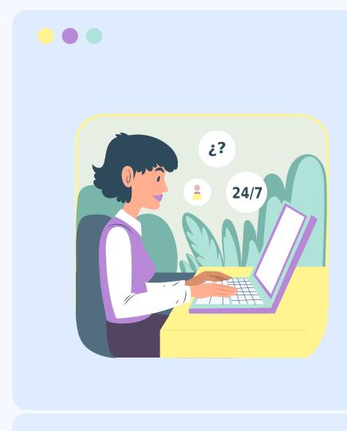
Relational Model
Staff, Student and Instructor are subtypes of User that have total specialization and overlapping constraints
Lab and Quiz are subtypes of Assignment relation that have partial specialization and overlapping constraints
Certificate and Degree are subtypes of Accomplishment relation that have partial specialization and disjoint constraints
We created an Evaluation Relation to define a many to many relationship between Module and Assignment
All the relations are in the third normal form as depicted with the Course, User and Course Material relations through green lines.
Solid underlines for primary keys
Dotted underlines for Foreign Keys
Notes:
Relation names
Attribute names in solid boxes
Primary keys- solid underlines
Foreign keys- dotted underlines

Slide 12
Normalization
First Normal Form
Remove multivalued attribute
All atomic attributes
All non-key attributes fully functional dependent on PK
Second Normal Form
3NF
No transitive dependencies
No partial functional dependencies
Third Normal Form
Notes:
For converting this relational model in 3nf--
split multi-valued attributes into separate relations
each attribute in the relation contains atomic values.
Eliminate any partial functional dependencies To bring to 2nf we split up user into student,staff and instructor to remove partial dependencies
Eliminate transitive dependencies eg.skill and specialization in the draft model to bring to 3nf
Each non key attribute is fully functionally dependent on the entire primary key

Slide 13

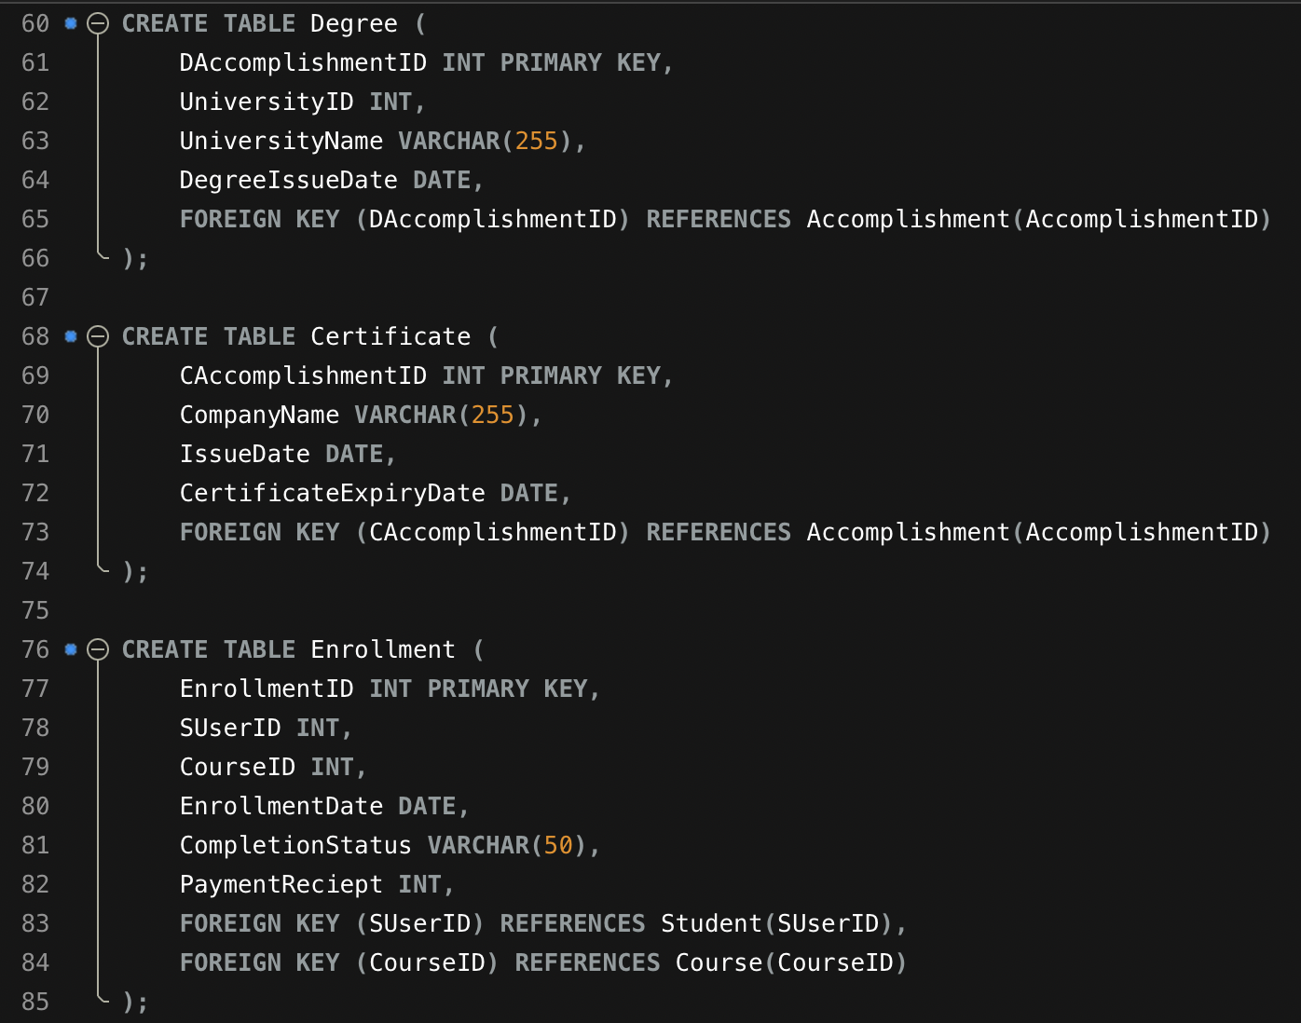
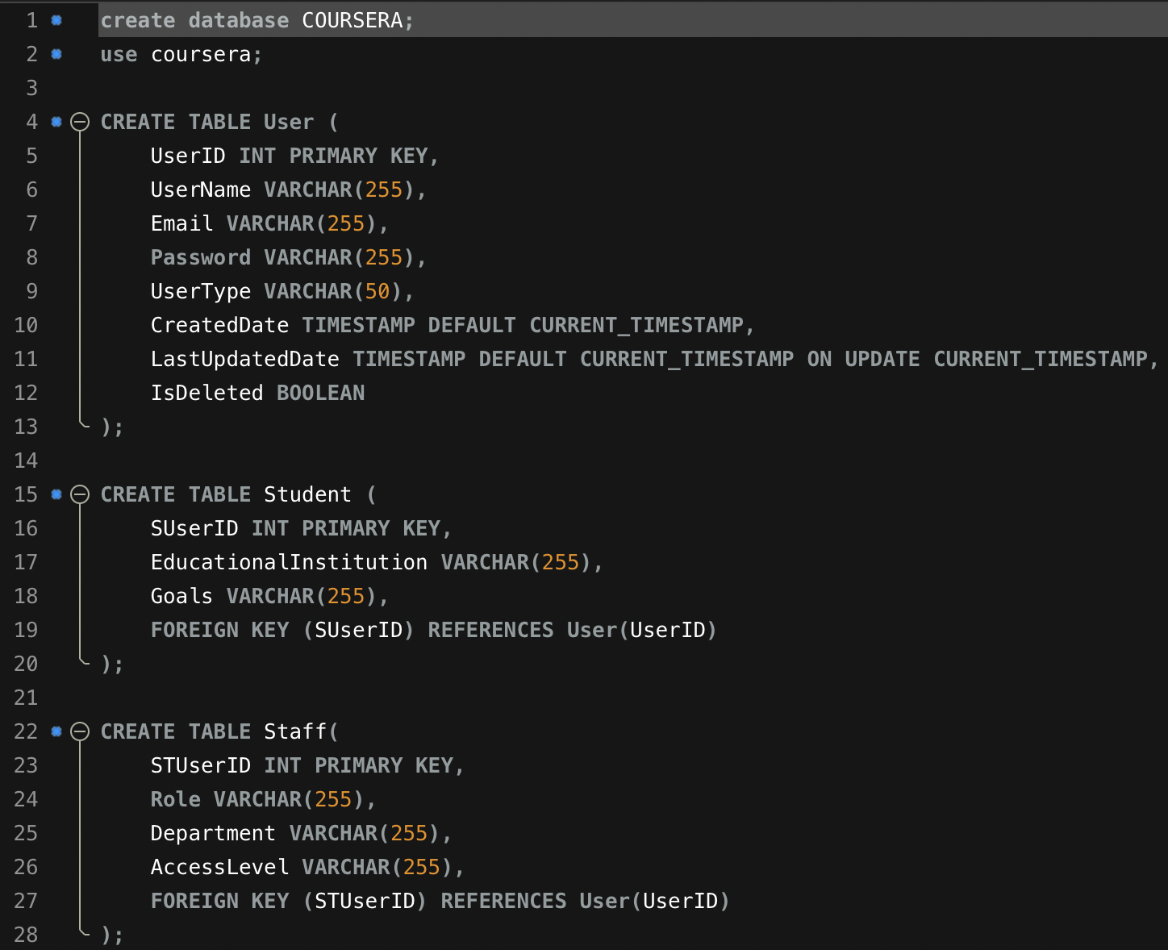
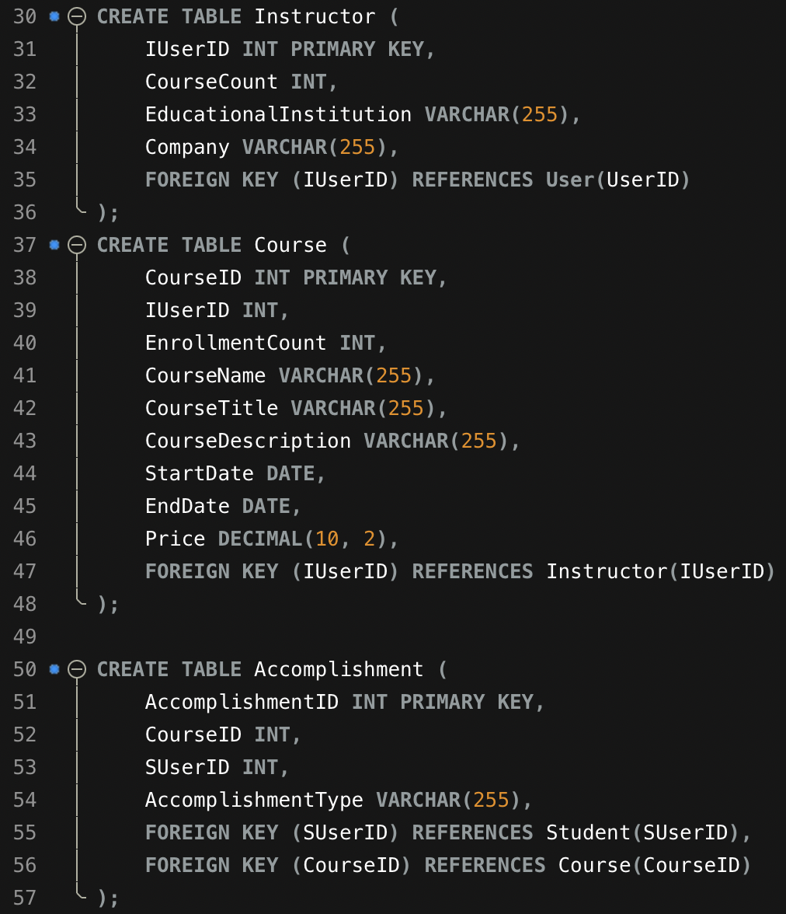
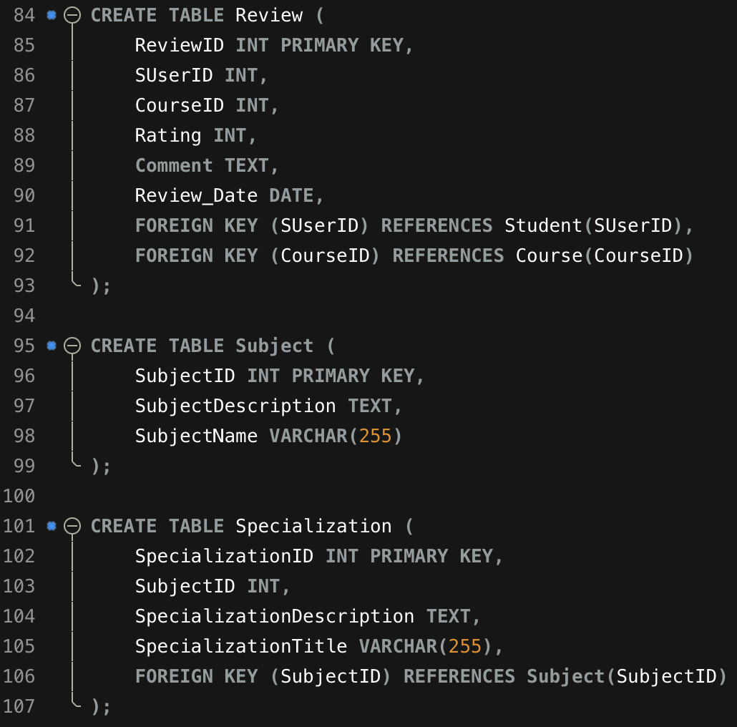
SQL Database - Table Creation
Notes:
Moving on to the implementation part of SQL db, this is how we have created the tables for our respective entities as in our ER and relational diagram
We have defined valid data types, PK constraint and FK referencing PK from other tables

Slide 14
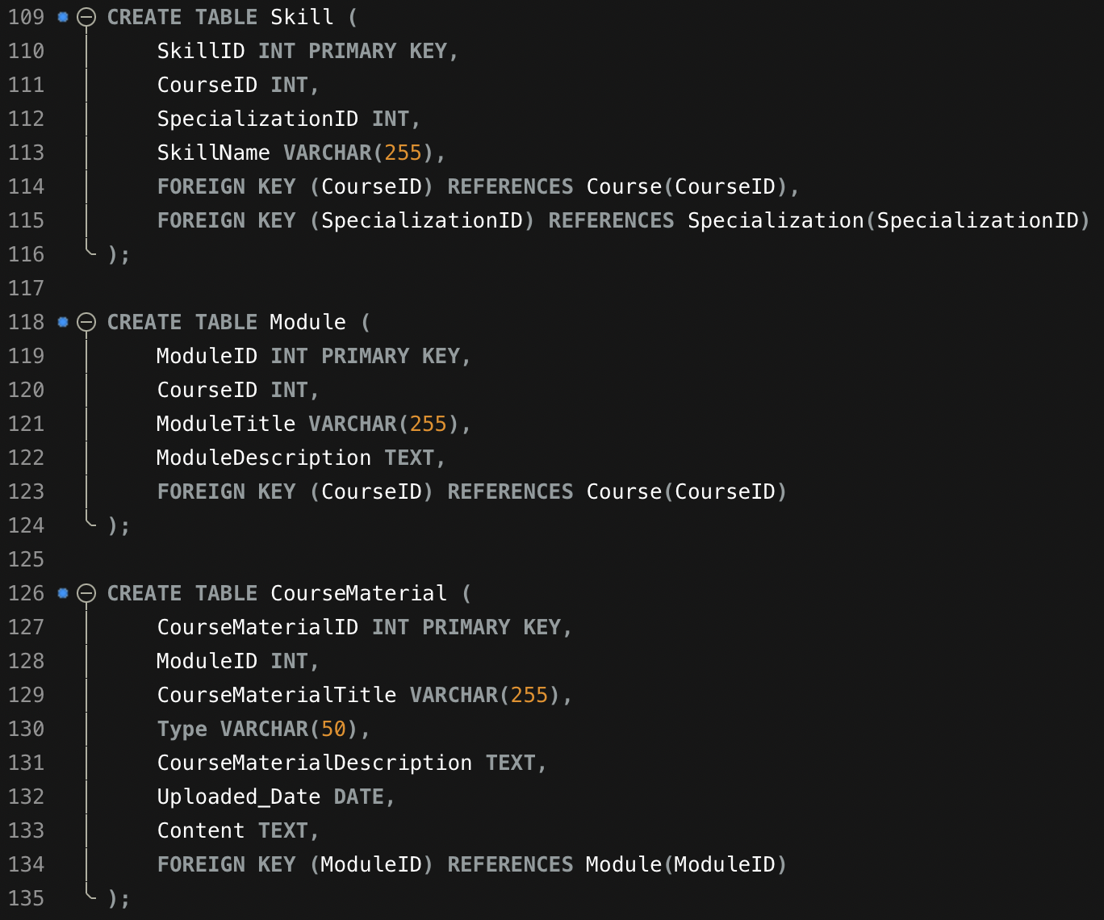
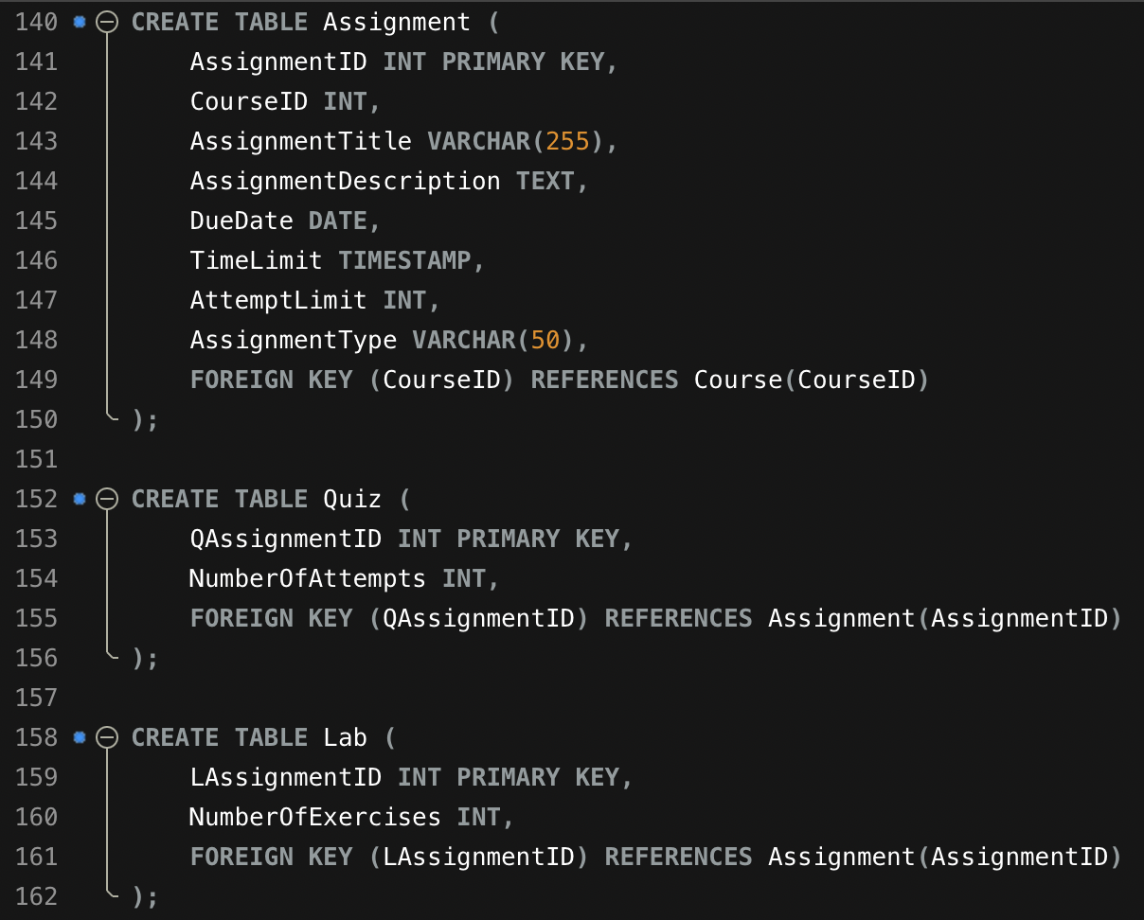
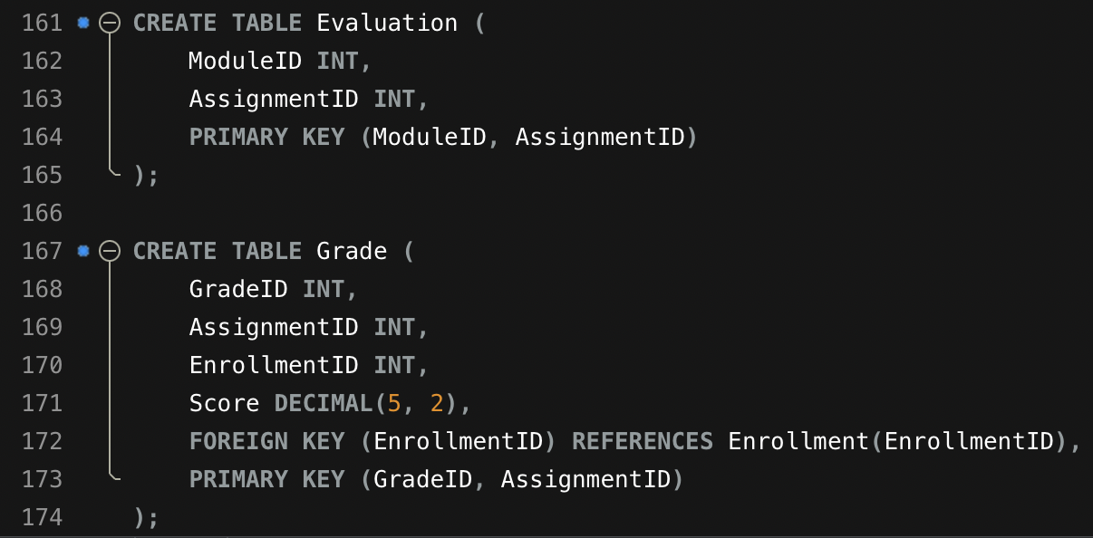
SQL Database - Table Creation

Slide 15
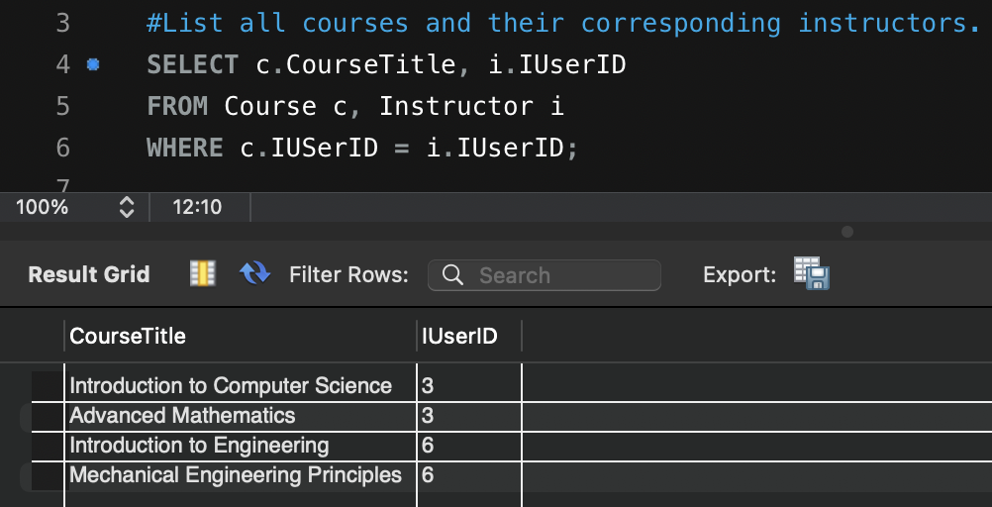
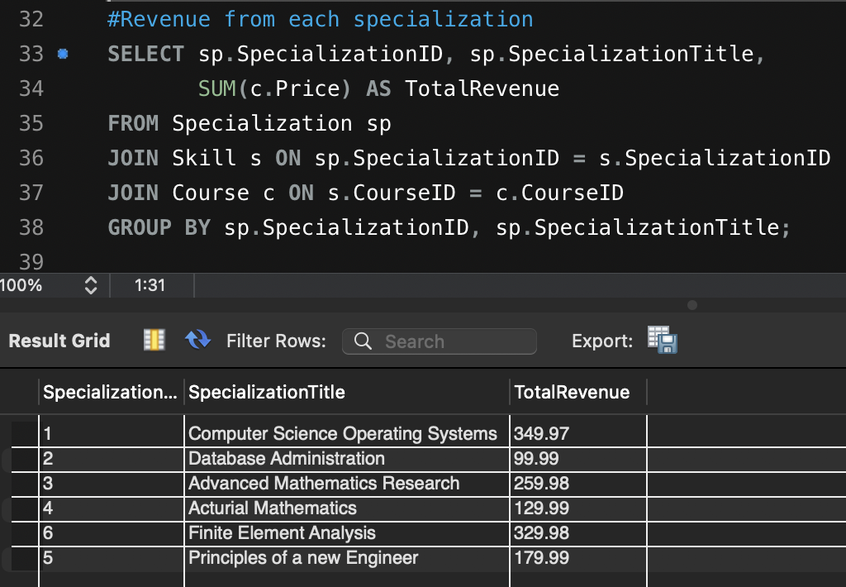
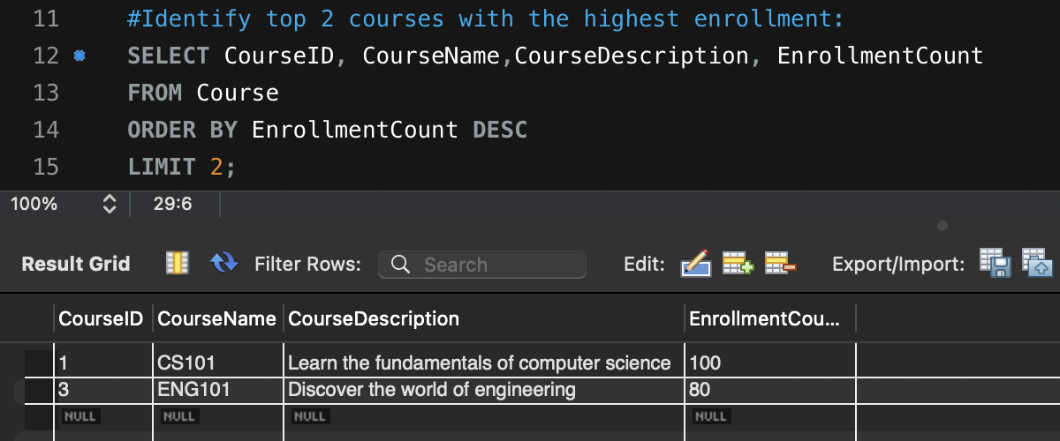
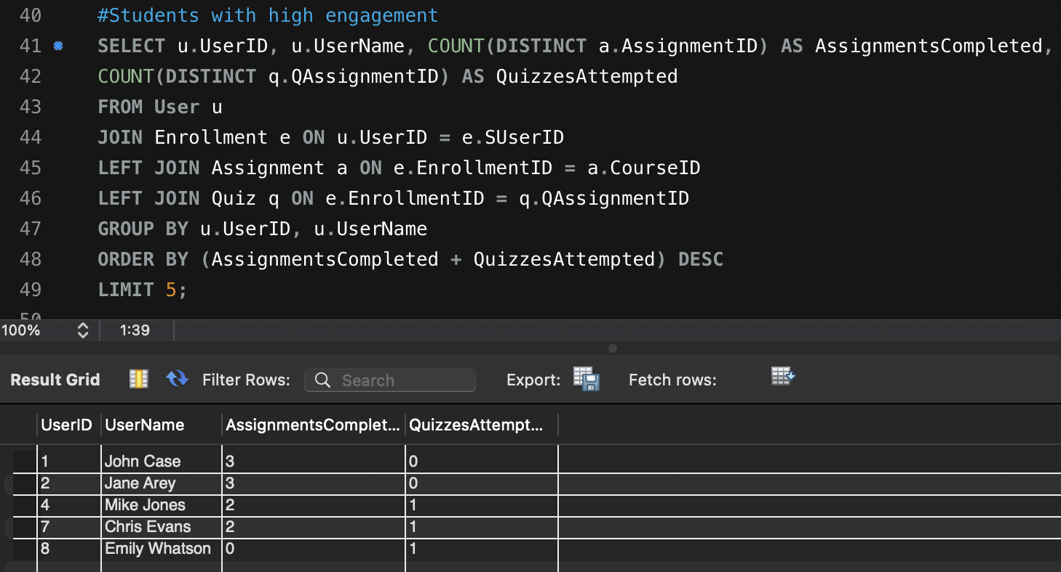
SQL Database - SQL Queries
Without Joins
With Joins
Notes:
We inserted some dummy data into our tables and then tried to implement some business functionalities using the basic & adv sql query
List all courses and their corresponding instructors without using join stmt
Identify top 2 courses in demand
Suppose we wish to check specialization that gives best revenue so we can join specialization, skill & course table
Then we tried to find the students with highest engagement -> Check the count of no assignment and quiz attempted by joining enrollment, assignment & Quiz

Slide 16
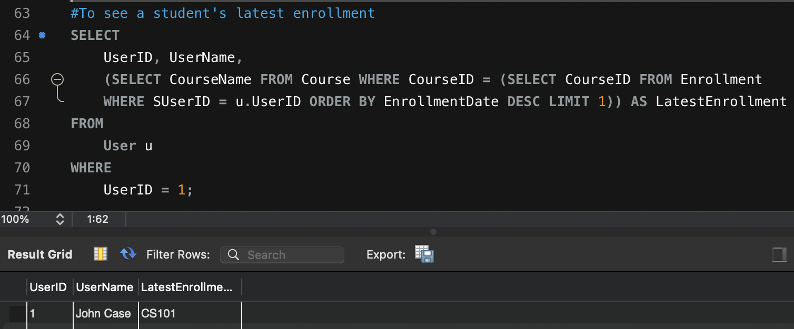
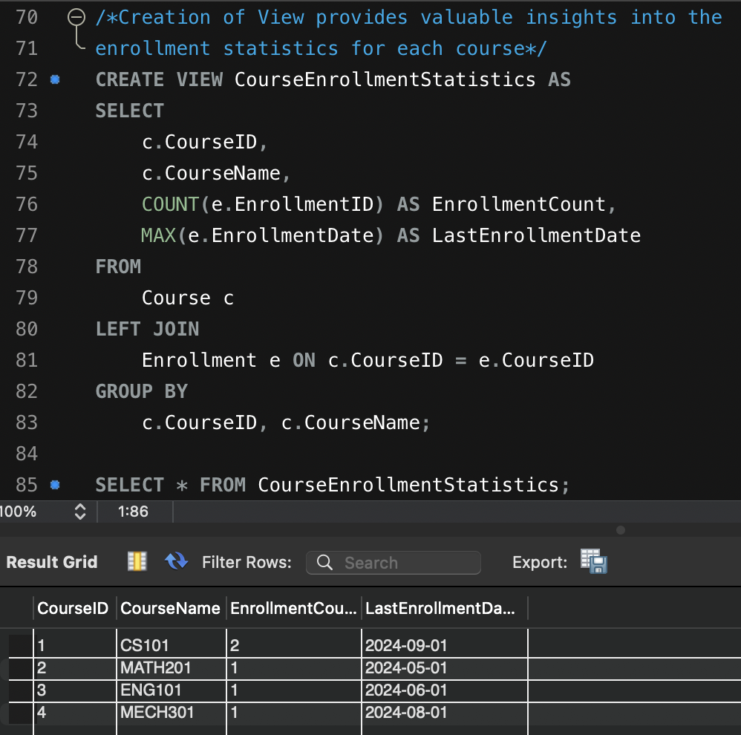
SQL Database - SQL Queries
Subqueries
Views
Notes:
Check which course has the user recently enrolled for
Create a view to provide the enrollment stats so we don’t have to query the table again, as view will be dynamically updated with any change in tables

Slide 17

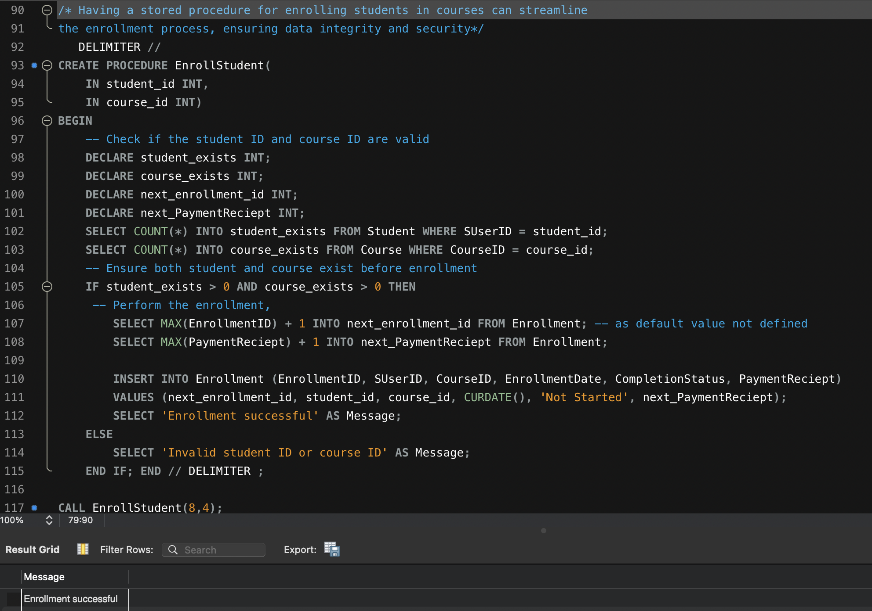
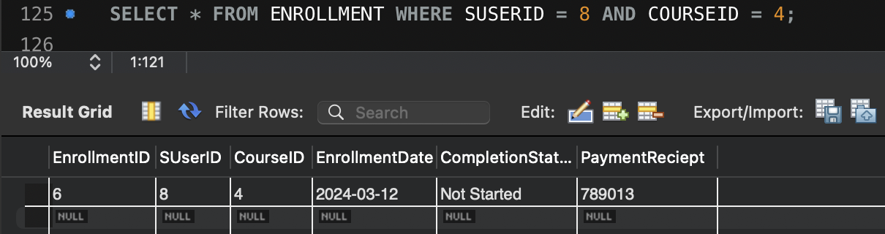
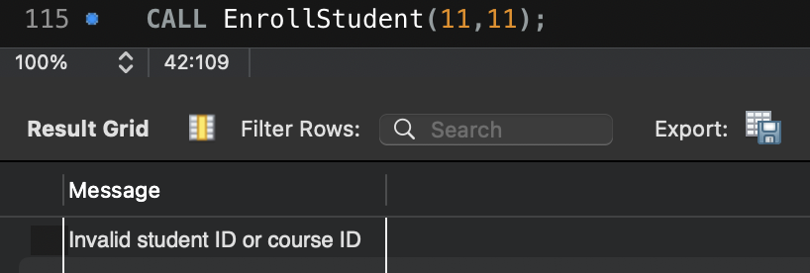
SQL Database - SQL Queries
Stored Procedure
Notes:
Create stored procedure to auto populate the enrollment table when there is a new user with a course

Slide 18

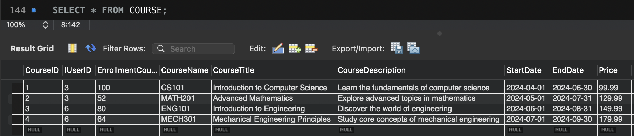
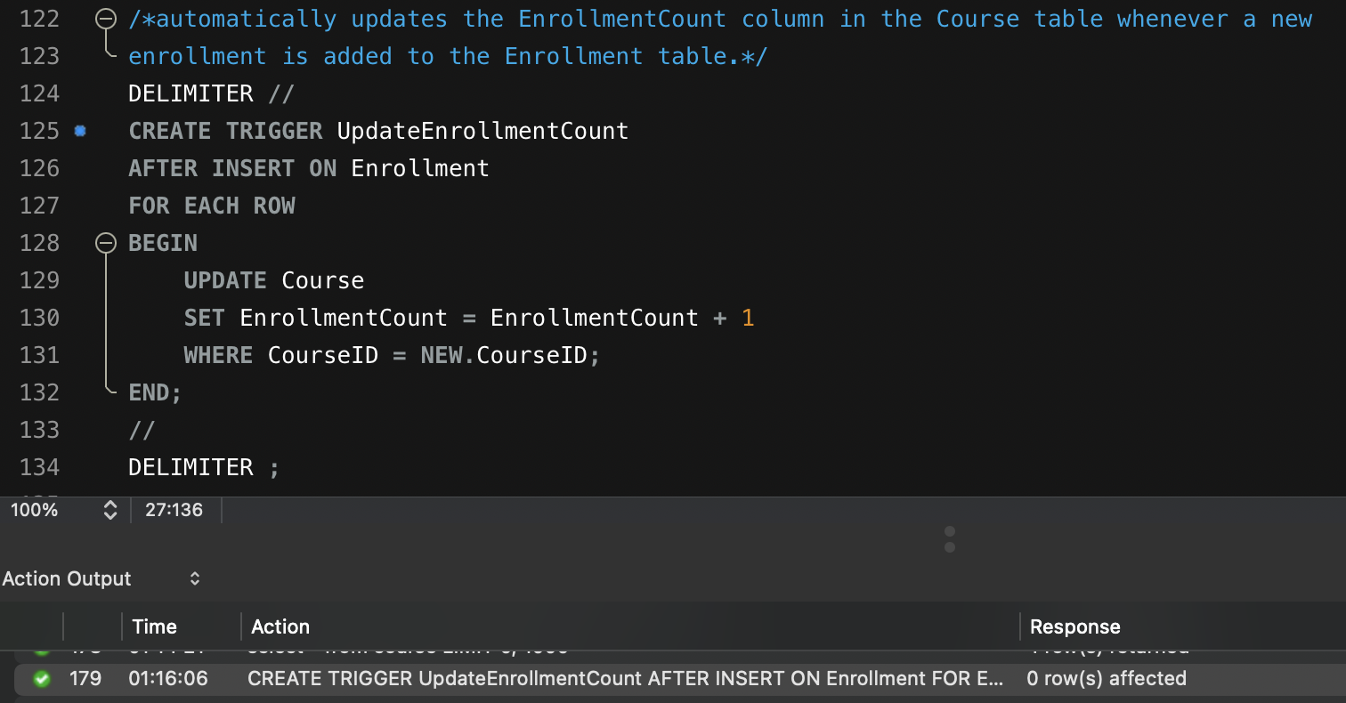
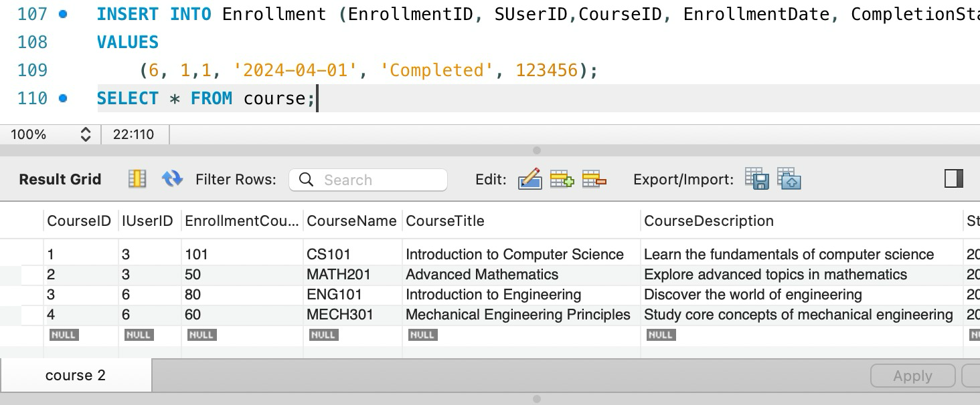
SQL Database - SQL Queries
Triggers
Notes:
Create trigger to auto increment enrollment count whenever a new enrollment is created
Like here we tried to query the course before trigger and after we can see enrollmentcount for courseid is increased by 1.

Slide 19
Data Administration - Security Controls
Access Control: Database must be on separate partition; remote access must be limited via secured protocols
Surface Hardening: Disabling services and accounts not required for business activities.
Network Security: Only necessary ports must be opened; IP whitelisting
Encryption: Data in transit(TLS v1.3) and Data at rest(AES-256)
Identification and Authentication: All access must follow principle of least privilege; strong password policies; account lockout; RBAC for Users
Logging and Monitoring: All activities on the database must be monitored and logged for audit or incase any incident.
Patch Management: Database must be up-to-date; vulnerability management
Backup and Restoration: Frequent backups must be taken to maintain availability.
Notes:
To ensure confidentiality, integrity and availability for our database, we have covered 8 security domains.
Starting with access control, where the db must be installed on the separate partition as OS, so that the DB cannot impact the base OS or any other server installed
We are ensuring Surface hardening, by disabling any unnecessary services installed.
Then we have Network security to have IP whitelisting, so that db must be accessible by authorized personnel only.
Implementing Encryption for both data at rest and data in transit.
Obviously, all password must adhere to company’s password policies
Enabling logging and monitoring of important activities which might be needed at the time of audit or incidents
Keeping the db up-to-date is also crucial to prevent any zero-day vulnerability
And lastly, backups must be taken on a seperate drive to ensure availability incase of any failure.

Slide 20
Data Administration- Implementation Challenges
● Data Modeling Naming Conventions: Adding uniformity and removing ambiguity from attribute and entity names
EX: Start_date —> StartDate
● Installing the DBMS Tools: We installed MySQL Workbench which required MySQL Server, connectors. Managing these dependencies and ensuring they are correctly installed and configured can be challenging, especially for users unfamiliar with the MySQL ecosystem.
● Adjusting data types: As we started implementing the database, we discovered that the data types for a few attributes needed to be modified. Changing data type after inserting values into the table challenges the data integrity of the particular attribute.
● Testing and Validation: Verifying the accuracy and completeness of the database implementation through rigorous testing and validation procedures is essential.
Notes:
Some of the challenges we faced were - naming convention (underscore, first letter with uppercase for each word)
Adjusting data types, after inserting records was challenging
Rigorous testing and validation to fix the DMLs so as to align with the execution of queries to retrieve data for business operations

Slide 21

Conclusion & Key Learning Points
Our Coursera database project has been instrumental in illustrating the practical application of database management systems within the context of an e-learning platform. By designing and implementing a robust database system, we have effectively addressed the complex data management requirements inherent to such platforms.
EER Diagram - Models the conceptual schema of database and displays the relationships and dependencies between
tables, and ensure data integrity and coherence
Relational Model Diagram - Models the logical structure of the database in terms of tables and relationships between entities in the Coursera database.
Advanced SQL Concepts - Joins, Subqueries, Stored Procedures, Triggers, and Views: Using advanced SQL concepts to derive metrics and analytics to support informed decision-making and optimize platform functionality.
Database Administration - Ensure the reliability, security, and performance of the Coursera database.
Notes:
To conclude this project on e-learning platform was really beneficial in designing and implementing a robust database system, understanding the key concepts of ER (deep dived into conceptual), Relational model (logical), Advanced SQL (where we explore joins, subqueries, views, triggers, etc all DMLs), DBA(learning about the imp of reliability, security & performance in db)

Slide 22
Thanks!
Any Questions?
Online help

